Slide 1
PELVIC EXAMINATION
4
Dr Shanthi Serene Sylum V MD(Hom)
Professor & HOD
Dept: Obstetrics & Gynaecology

Slide 3
It includes,
Inspection of the external genitalia
Vaginal examination
Inspection of the Cx & Vaginal walls.
Palpation of vagina & vaginal cx by
digital examination.
Bimanual examination of pelvic organs.
Rectal examination
Rectovaginal examination

Slide 4
Pre-requisites are,
Request self empty bladder except
stress incontinence.
Lower bowel should be empty {rectum &
pelvic colon}.
A female attendant.
Get consent from the pt or guardien
for examining a minor or unmarried.
Very good light source.

Slide 5
Requirements
A calm, aerated & well lighted room
Examination table
Pillow & drapings
Examining sterile gloves
Sterile lubricant
Speculum
Sponge holding forceps
Swabs - cotton balls, Pads
Arey’s spatula
Cyto brush
2 glass slides & cover slips
Fixative {liquid or spray}

Slide 6
Position of the patient for pelvic examination
Dorsal position – Commonly adopted one
Hip & knees flexed
completely
Lateral or Sim’s Ideal to view anterior
Position vaginal wall.
Lithotomy position – Ideal for examination
under anaesthesia in OT
& vaginal operations

Slide 7
Positions

Slide 8
Position of the physician for pelvic examination
Physician stands on Rt side - It provides a better view of external genitalia
It gives an effective performance
of bimanual examination
BUT
The physician can be examined in any
position of the physician’s choice.
Notes:
Ref: Dutta – Page 94

Slide 13
Components of pelvic examination are
Inspection of the vulva
Speculam examination
Inspection of vagina & cervix
Digital examination
Palpation of the vagina & cx
Bimanual examination
Bimanual Palpation of the
uterus & the adnexia

Slide 14
Inspection of the vulva

Slide 16
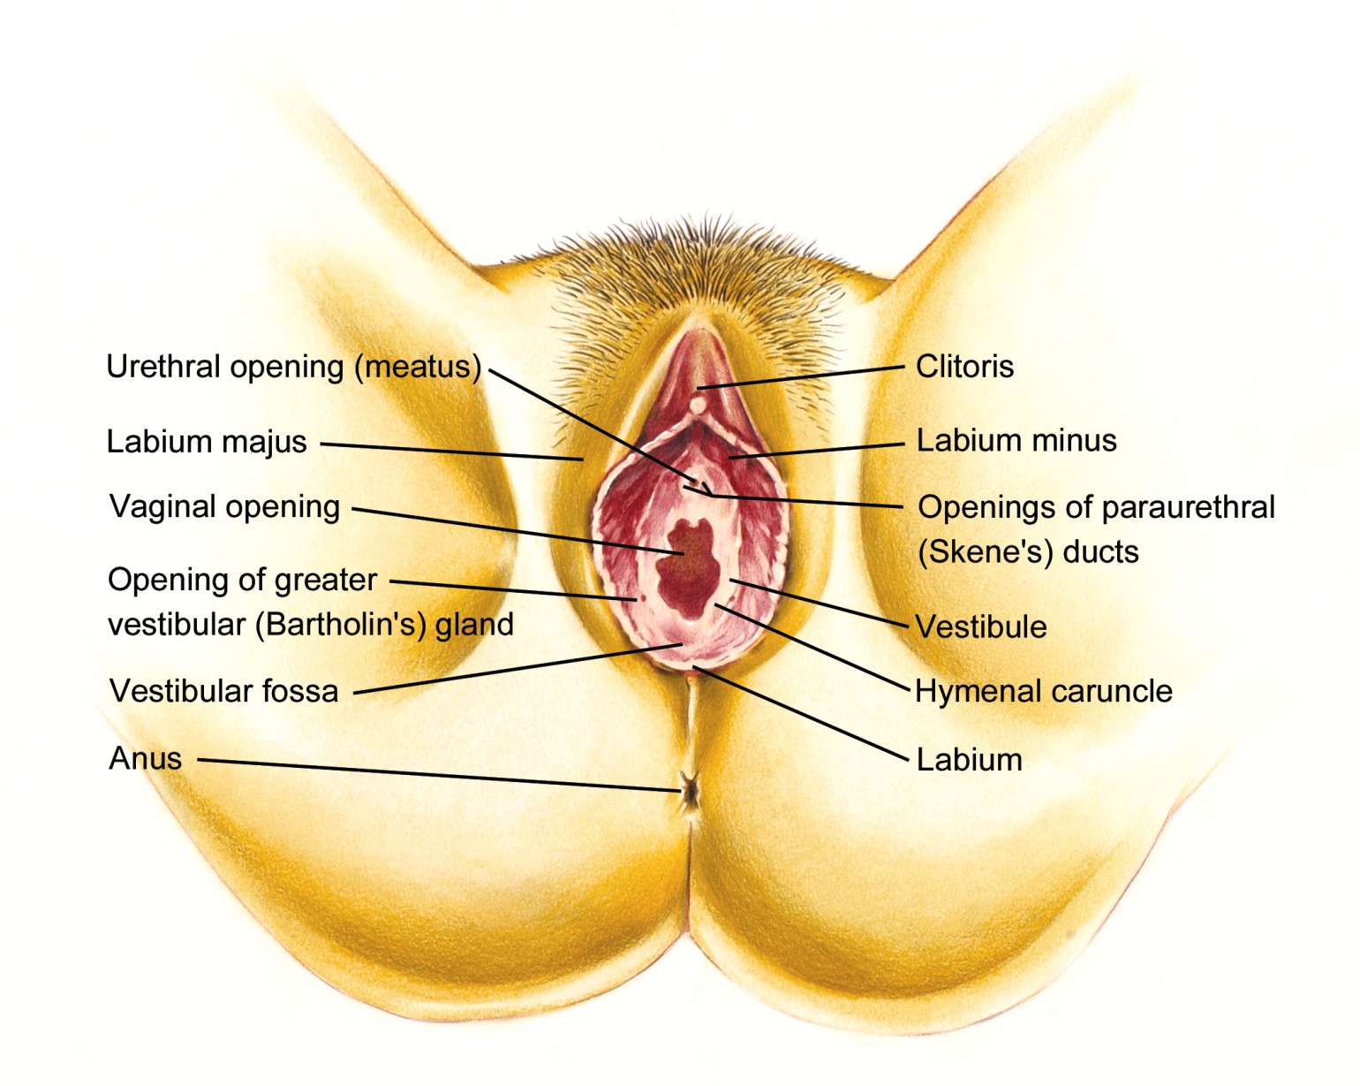

Slide 17
Inspection of the vulva
Mons pubis
Labia majora
Labia minora
Perineal body
Anal region
Fourchette
Fossa navicularis
Vagina
Vestibule
External urinary meatus
Clitoris
Prepuce
Frenulum

Slide 18
Mons pubis
Lies above the pubic symphysis
Composed of fibrofatty pad of tissue
posses dense pubic hair distributed as an inverted triangle in adults
Pubic hair start to grow from 11-12 yrs

Slide 19
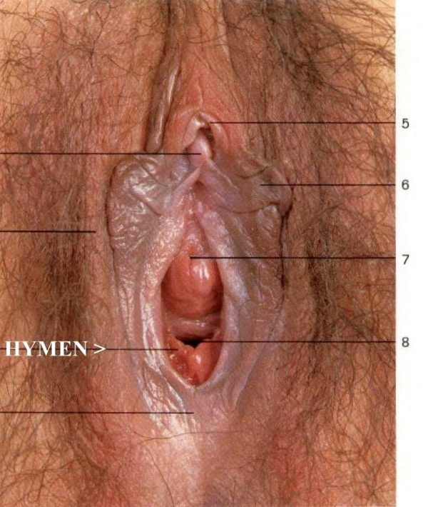
Labia majora
They are two longitudinal cutaneous folds lined by squamous epithelium with hair follicles sweat glands & sebaceous glands.
Extends anteriorly to Mons pubis & posteriorly joins medially to form the posterior commissure in front of the anus to enclose the pudendal cleft.
Inner smooth surface is hairless.
Outer surface covered with dense hair.
It is homologous with the male scrotum.

Slide 20
Labia minora
They are two longitudinal cutaneous folds enclosed by Labia majora.
Anteriorly it divide & unite to enclose the clitoris to form prepuce & frenulum
Posteriorly it fuse at midline to form fourchette.(it may lacerate during child birth).
Fossa navicularis forms between fourchette & vaginal orifice.
Devoid of hair follicles.
It possess connective tissue, sebaceous glands, erectile muscle fibers, rich blood vessels & nerve endings.

Slide 21
Clitoris
Female homologue of penis but it is separate from urethra.
Small cylindrical body measuring 2.5cm.
It consist of a glans, a body & 2 crura.
Glans is covered by squamous epithelium & rich nerve supply.
Body consist of 2 corpora cavernosa of erectile tissue enclosed in a fiberous sheeth.
Suspensory ligament attach Clitoris to the under surface of pubic symphysis.
It plays an important role in sexual stimulation & function

Slide 22
Vestibule
Triangular space
Boundaries –
ant – clitoris
post – fourchette lat – labia minora
Four external openings in vestibule are –
-urethral opening
- vaginal orifice
- bartholin’s duct opening
- skene’s duct opening

Slide 23
urethral opening
Located in the midline
1.0 – 1.5 cm below the pubic arch &
In front of the vaginal interoitus
Skene’s/ paraurethral duct open either in the posterior wall of the urethral orifice or directly into vestigule

Slide 24
Vaginal orifice
Lies in posterior end of vestibule
Varies in size & shape
Covered by hymen
Rupture at the consummation of marriage
Extremely lacerated during child birth
Later cicatrised nodules remains as carunculae myrtiformes

Slide 25
Inspection of the vulva
anatomical abnormalities
Skin abnormalities
Palpable pathology
Character of visible vaginal discharge
Condition of external urethral meatus
Bartholin’s duct opening {if inflamed}
Character of hymen
Request straining to elicit
stress incontinence
genital prolapse
Haemorrhoids, Anal fissure, Fistula

Slide 26
anatomical abnormalities

Slide 27
Skin abnormalities

Slide 28
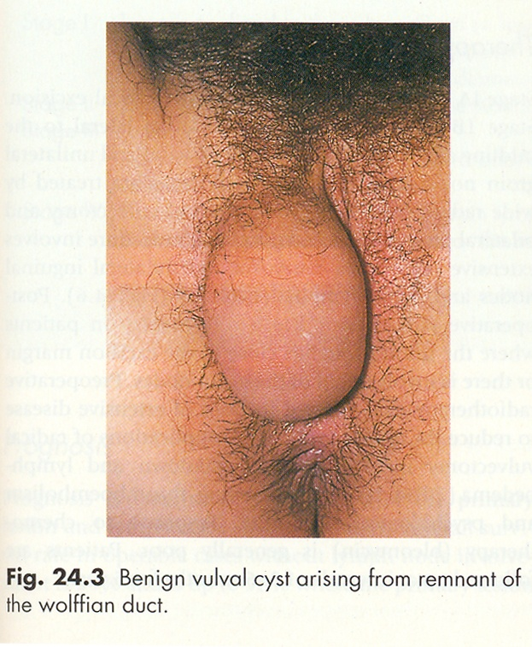
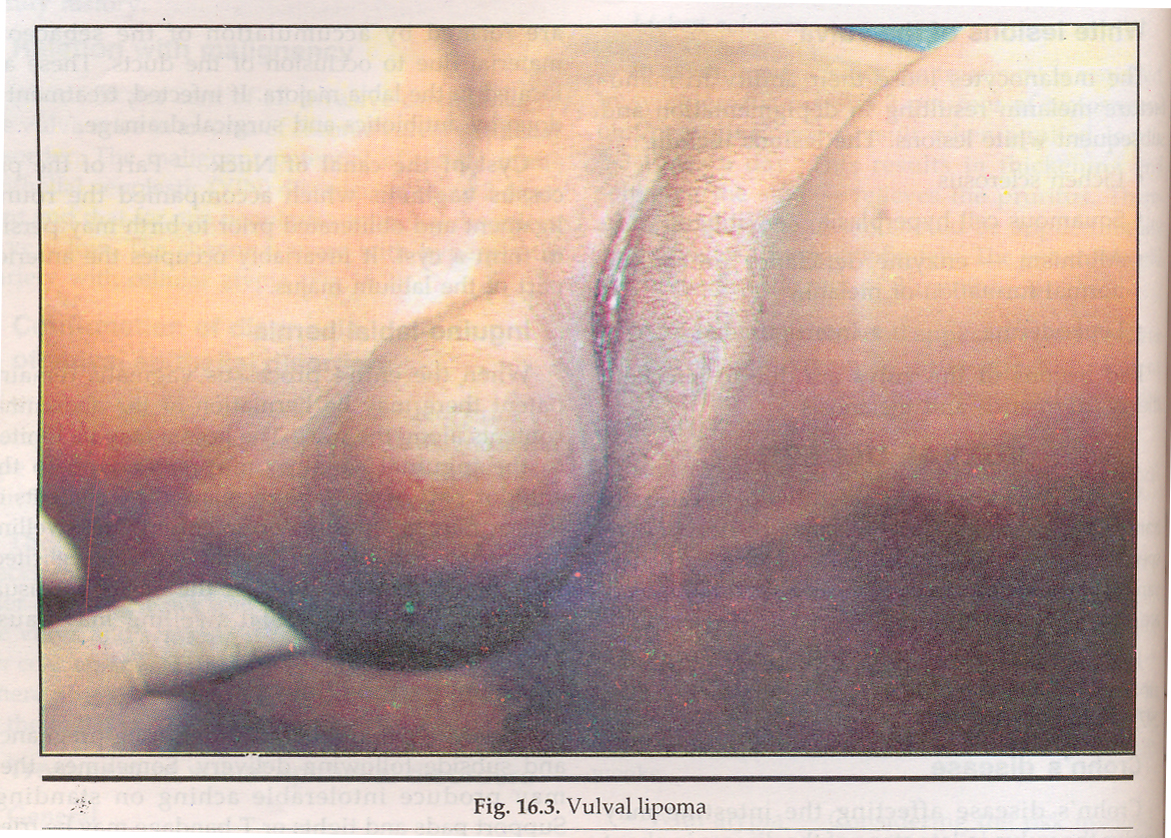
Palpable pathology

Slide 29
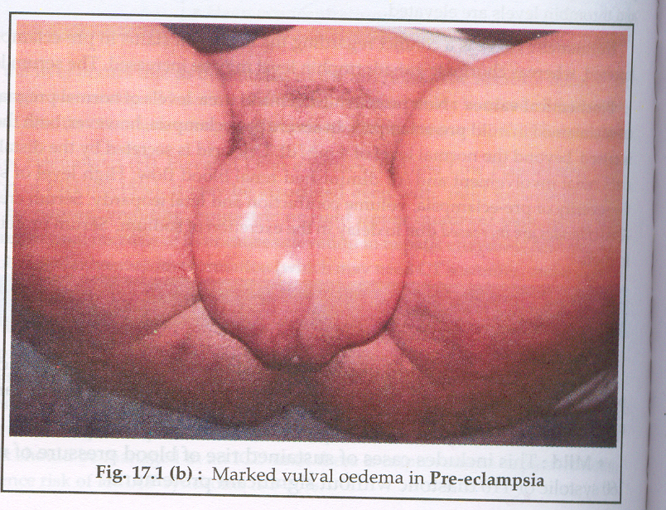

Slide 30
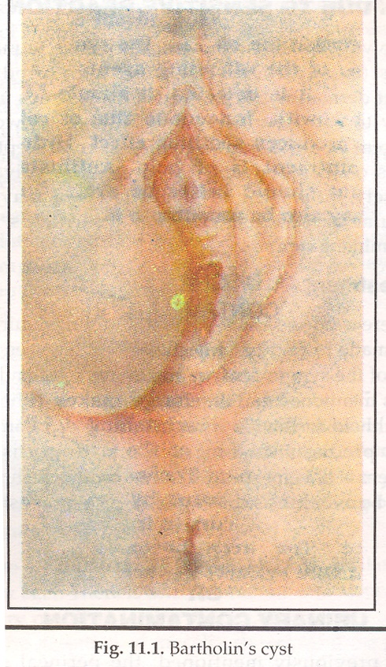
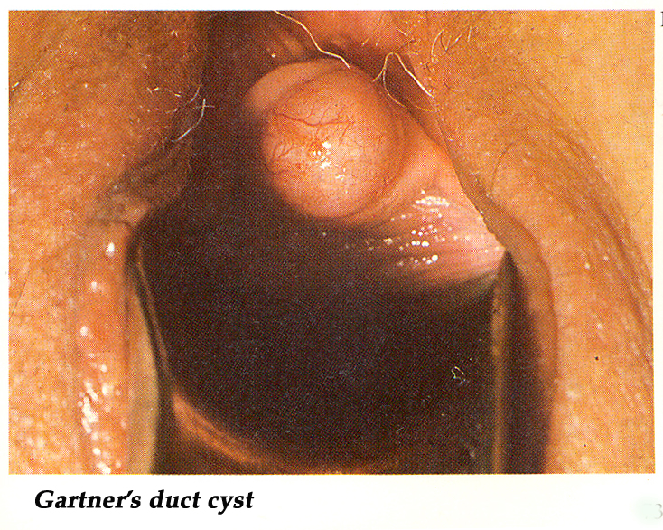

Slide 31
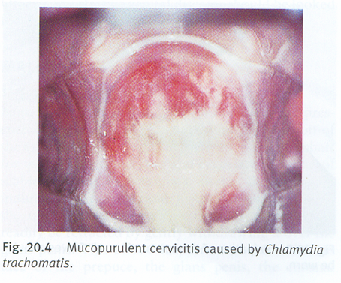
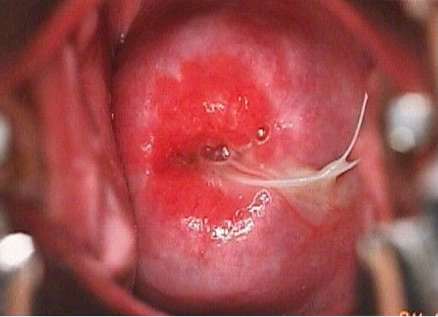
Character of visible vaginal discharge

Slide 32
Condition of external urethral meatus

Slide 33
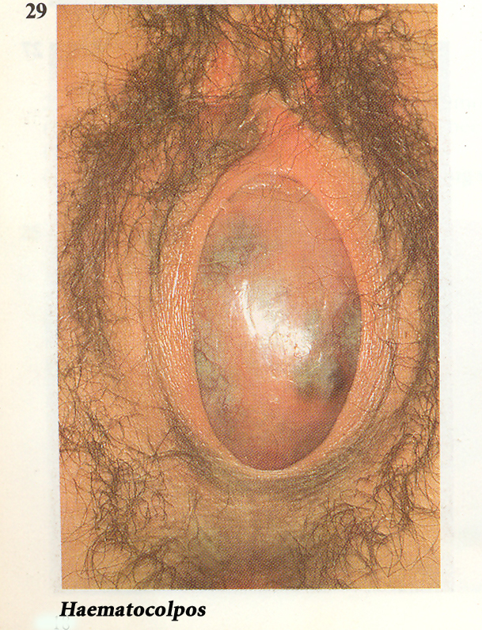
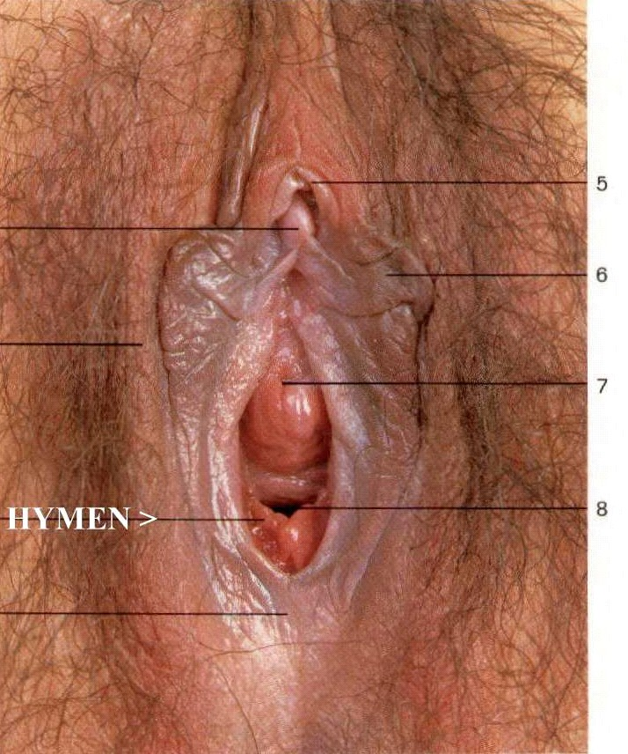
Character of hymen

Slide 34
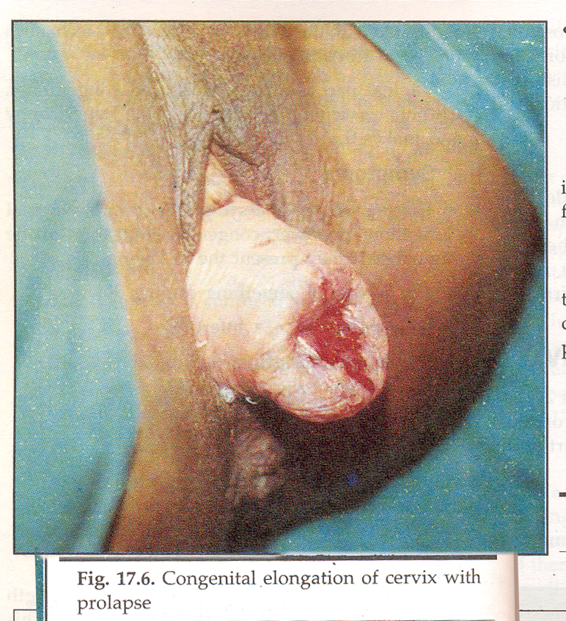
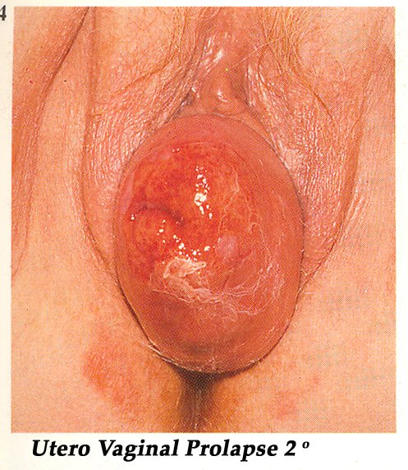
genital prolapse

Slide 35
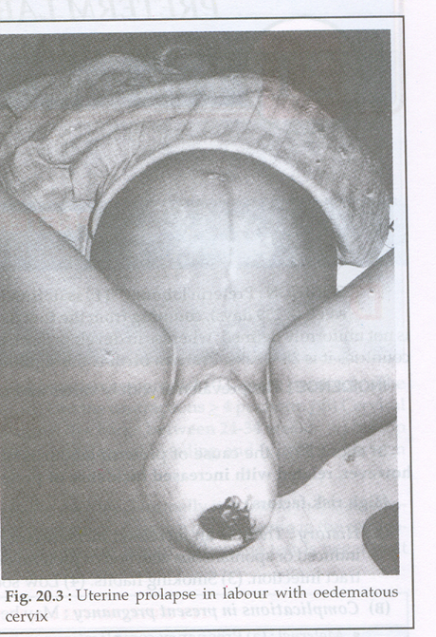
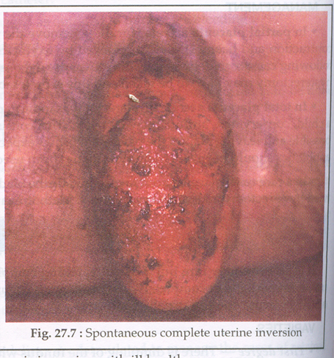

Slide 36
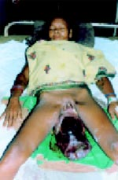
Prolapsed uterous due to huge cervical fibroid

Slide 37
incontinence
Stress test in the lithotomy position
There are many ways of performing the cough stress test. Here, the stress test was done in the lithotomy position and a positive test was elicited.

Slide 38
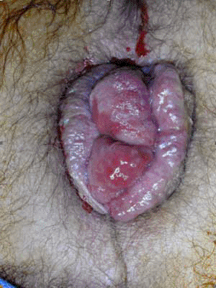
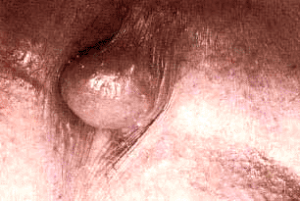
Haemorrhoids
Grade III internal hemorrhoids with surrounding external hemorrhoidal tissue
Thrombosed external hemorrhoid

Slide 39
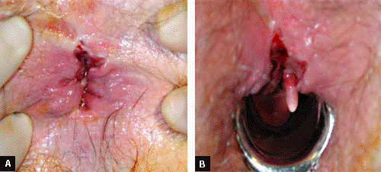
Anal fissure
Gentle separation of the buttocks to expose the distal anal canal generally establishes the diagnosis of an anal fissure without undue discomfort to the patient.
With an anoscope in place, a hypertrophied anal papillae is seen proximally to the anal fissure (sentinel tag not present).

Slide 40
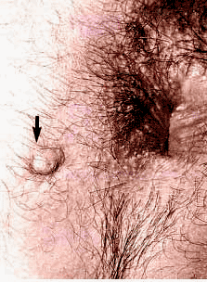
Fistula
Hypertrophic granulation tissue at site of drainage indicating the external fistula opening
A, ulcerated skin tags; B, multiple complex fistulae.

Slide 41
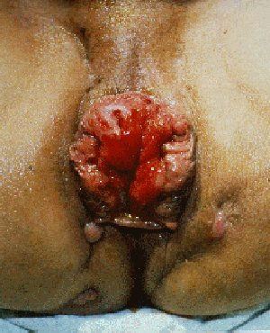

Slide 42
INSPECTION OF VAGINA & CERVIX

Slide 43
INSPECTION OF VAGINA & CERVIX
It is done by speculum examination to find colour, discharge & lesions.
It is done before digital examination because –
A. In cervical lesions, bleeding can be avoided if speculum examination is done before digital examination.
B. Cervical scraping & endocervical sampling for cytological examination can be done in one sitting for screening.
C. Cervical & vaginal discharge can be taken for Bacteriological examination.

Slide 44
Various types of speculums are available-
1. Cusco’s speculum
2. Sim’s speculum
3. Ferguson’s speculum

Slide 45
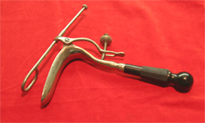
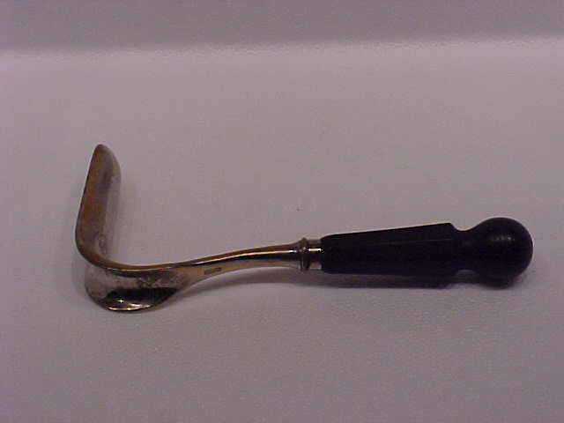
THOMUS SIM’S SPECULUM
Speculum with wood handle

Slide 46
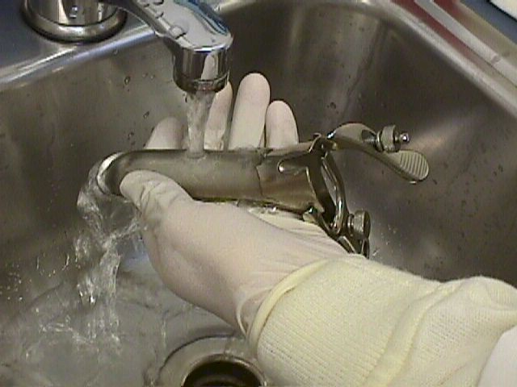
1. Cusco’s speculum

Slide 47
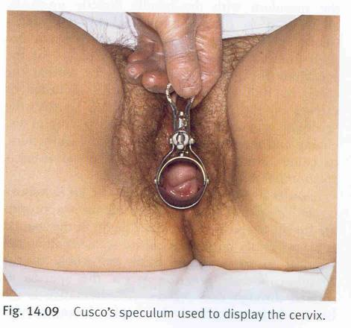
Cusco’s – used in dorsal position
cervix can best visualised with it.
Collection of discharge from cervix or vaginal fornics made easy.

Slide 48
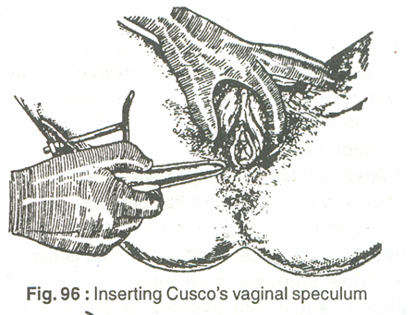
Procedure
It should be explained to the patient first.
Moisten speculum
Hold in Rt hand
Separate the labia with
thumb & index finger
of Lt hand.
Hold speculum blade in an oblique direction & insert into vagina .

Slide 49
Then rotate gently to transverse plain on the posterior vaginal wall.
Speculum position is adjusted till the cx & vagina can be viewed

Slide 51
Vagina appearance

Slide 52
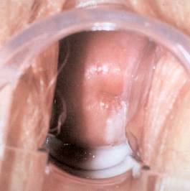

Slide 54
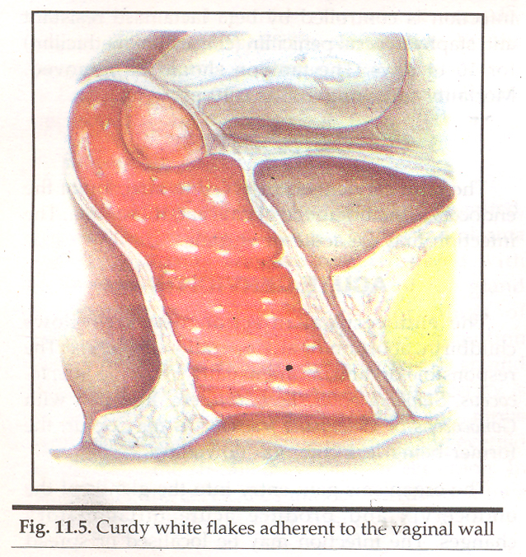
Trichomoniasis
Moneliasis / candidiasis

Slide 56
In case of obstetrics -
Ectocervix for bluish discoloration associated with pregnancy (Chadwick’s sign)
Vagina for bluish discoloration in pregnancy – Jacquemier’s sign
Lesion in cervix & vagina
- Infective ulcers
- Neoplastic (ca cervix)
- Traumatiic ( lacerations)

Slide 57
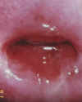
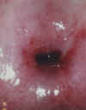
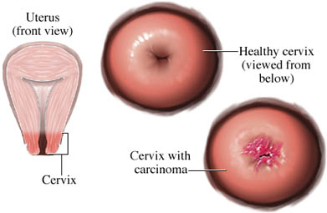
Normal multiparus cx
Post menopausal cx

Slide 58
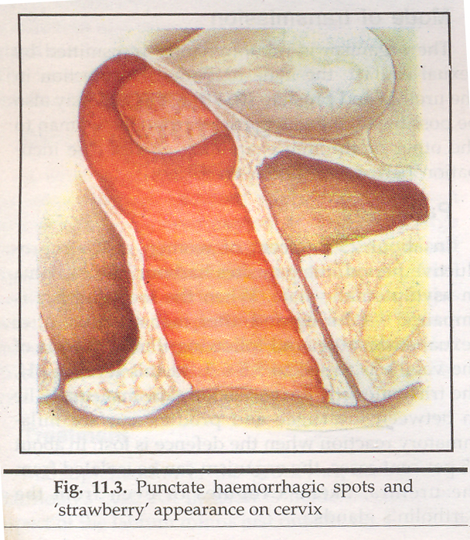
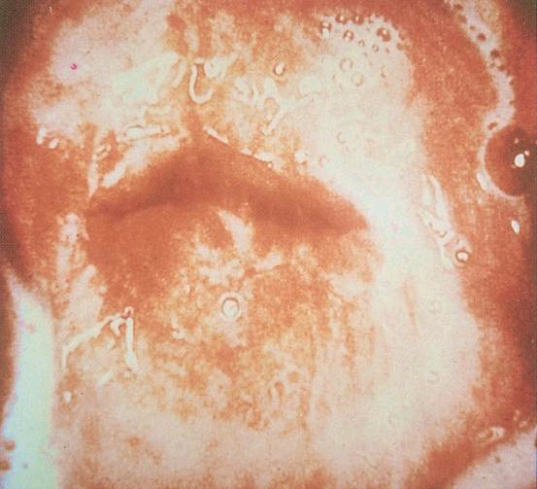
Trichomoniasis
strawberry cx

Slide 59
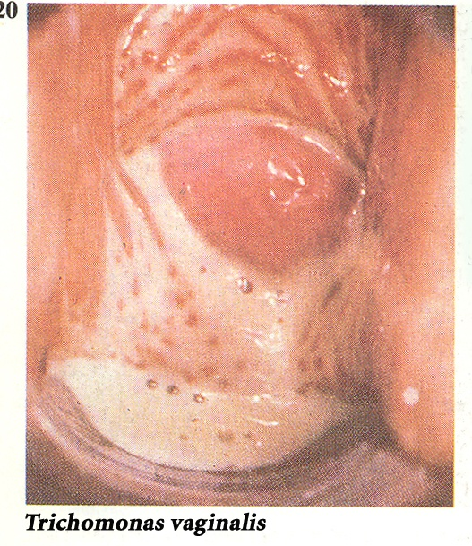

Slide 61
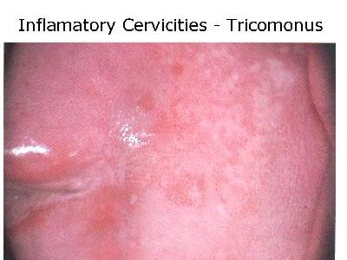

Slide 62
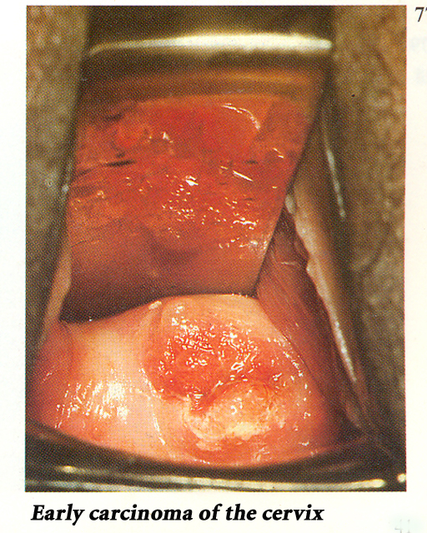
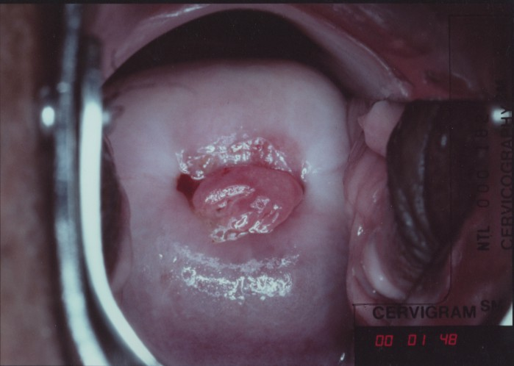
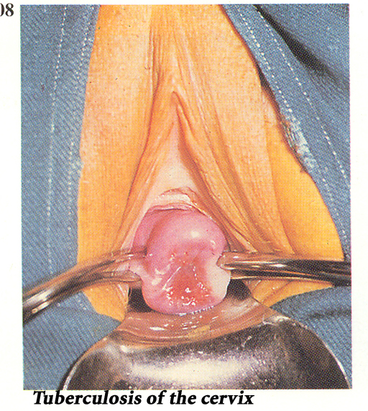

Slide 64
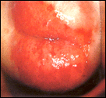

Slide 66
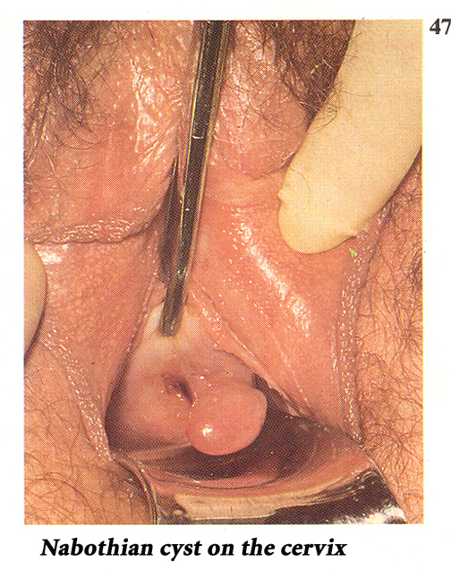

Slide 69
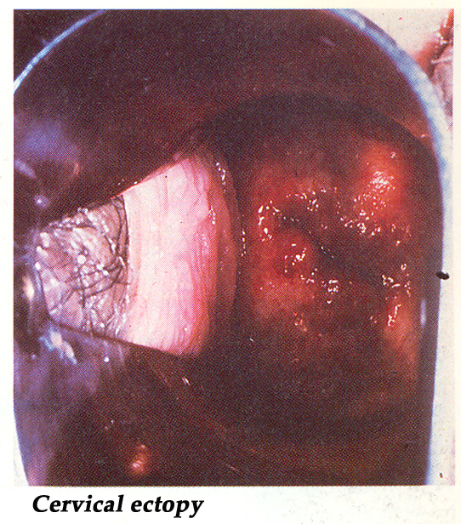

Slide 70
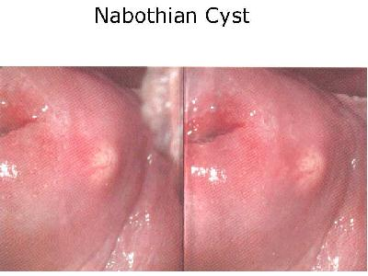
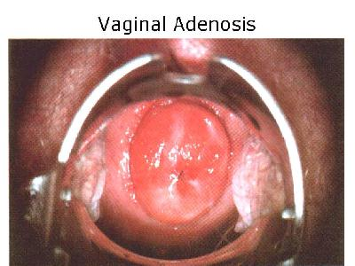
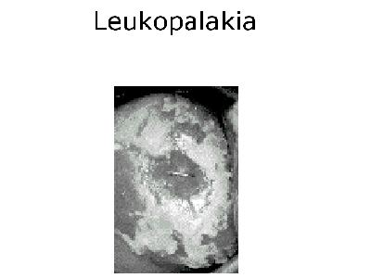

Slide 71
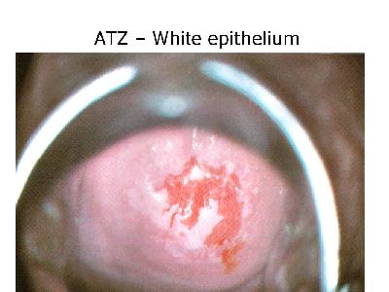
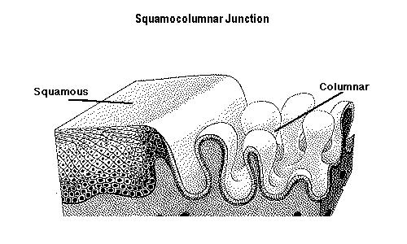

Slide 72
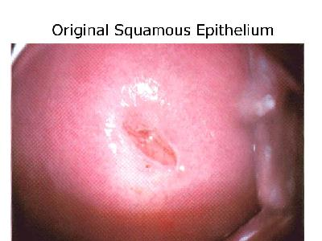
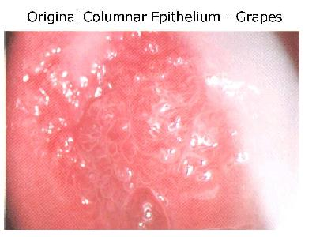
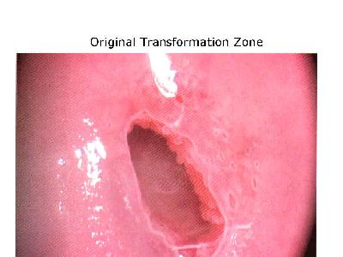

Slide 73
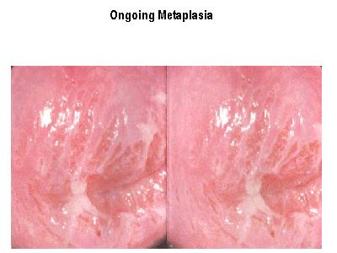

Slide 74
2. Sim’s speculum or Duckbill speculum & Anterior vaginal wall retractor
It is designed to hold back the posterior vaginal wall
to expose the anterior vaginal wall & cervix.

Slide 75
Sim’s + (Anterior vaginal wall retractor) - Used in lateral position
Anterior vaginal wall is best visualised by sims .
It is best to view genital Prolapse.

Slide 76
Inspection of the anterior vaginal wall
A half posterior vaginal clear plastic disposable speculum is used to inspect the anterior vaginal wall.
The patient has a mild grade 1 cystourethrocele: the urethra and the floor of the bladder are minimally sagging without touching the surface of the speculum.
The vaginal mucosa is healthy and not atrophic.

Slide 77
3. Ferguson’s speculum
It is a metal tube.
It is used in cases of marked vaginal prolapse when Cusco’s speculum cannot hold back the vaginal wall sufficiently to view the cx.

Slide 78
View it in lateral position Where the cervix cannot be seen in dorsal position.

Slide 79
Pap smear

Slide 80
Pap’s smear

Slide 81
Pap’s smear collection

Slide 83
DIGITAL EXAMINATION

Slide 84
DIGITAL EXAMINATION
It is done with gloved & sterile lubricated index &middle Finger. Avoid in vergins with intact hymen
or
do it under anaesthesia. Labia is separated to inspect - Introitus - Clitoris - External urinary meatus
Labial swelling - Bartholin’s cyst - Abscess

Slide 85
Procedure
one finger internal and other finger externally
placed.
Press urethra above down ward to extract
Urethral discharge through meatus
Integrity and tone of the perineal body and lateraly the levator ani Muscle can be palpated

Slide 86
Palpation of vagina & cervix
Cervix is identified by a dimple – ext os
Lenth – 2.5 – 3 cm
Mobility – 1 cm in all direction

Slide 87
Vaginal cervix
Direction - Anterior lip feels first in anteverted uterus
External os or post lip feels first in
Retroversion = normal if not fixed.
Station - external os normaly kept at the leval of
Ischial spines.
Texture - Firm - non pregnant state
- Soft - pregnancy
Shape - Conical and smooth – in nulliparous
Cylindrical - in parous
External os - Smooth and round in nulliparous
Dilated and with or without tear in Parous.
Movement - Painful - PID, disturbed ectopic preg
Painless
Contact bleeding.- cervical erosion, ca cx

Slide 88
BIMANUAL EXAMINATION

Slide 89
BIMANUAL EXAMINATION
TO PALPATE
UTERUS
UTERINE APPENDAGES
POUCH OF DOUGLAS

Slide 91
Procedure
Exert pressure over perineal body to relax perineal muscles.
Insert gloved right index and middle finger smeared with lubricants into vagina.
Narrow and tender introitus allow only one finger.
Place left hand above symphysis pubis to palpate pelvic organs.
Keep examining fingers away from clitoris &
Uethral meatus to avoid discomfort to patient.
To relax Abdominal muscles request patient to breath through mouth.

Slide 92
Place pervaginal fingers in anterior fornix & exert
Pressure at utero cervical junction upwards towards lumbar vertebrae.
Left hand give pressure downwards and forwards to bring the pelvic organs closer to vaginal fingers.
So both Hands can feel the uterine outline in anteverted uterus.
Retroverted uterus can be felt if internal fingers push up Uterus through post fornix.
Exert pressure over perineal body to relax perineal muscles if in need.

Slide 96
Normal uterus is anterverted, pear shaped firm & freely mobile.
FIND OUT-
- Uterine outline - regularity
- position
- size
- Shape
- consistency
- mobility

Slide 97
Non pregnant uterus - Firm
Pregnant uterus - Uniformly enlarged & soft
At 8-10 weeks of gestation - Hegars’s sign, softening&Compressibility of uterus
In uterine tumor - Firm & irregularly enlarged (fibroid)

Slide 99
PALPATION OF UTERINE APPENDAGES
Palpate right & left lateral fornix
Simultaneously palpate with abdominal
Hand on respective right or left lower quadrent by exerting Counter pressure Downward.
Normal tube & ovary are not palpable.

Slide 100
Palpate posterior fornix for
- Faecal mass in the recto sigmoid (normal)
- Body of retroverted uterus
- Mass or nodules in pouch of douglas
In case of adnexal mass assess its :-
size
consistency
pulsatility
tenderness
mobility

Slide 101
In case of obstetrics -

Slide 102
(3) Hegar's sign.
This is softening & compresibility of the lower uterine segment just above the cervix. When the uterine is compressed between examining fingers, the wall feels tissue paper thin. The physician will use bimanual maneuver simultaneously (abdominal and vaginal) and will cause the uterus to tilt forward. The Hegar's sign is noted by the 6th – 12th week of pregnancy especially in primi.

Slide 104
Internal Ballottement.
This is demonstrated during the bimanual exam at the 18th to 20th wk in cephalic or breech prescentation. Ballottement is when the lower uterine segment or the cervix is tapped by the examiner's finger and left there, the fetus floats upward, then sinks back and a gentle tap is felt on the finger. This is not considered diagnostic because it can be elicited in the presence of ascites or ovarian cysts

Slide 107
RECTAL OR RECTO ABDOMINAL EXAMINATION

Slide 108
RECTAL OR RECTO ABDOMINAL EXAMINATION
Indications
- Children
- Adult virgins
- Painful vaginal examination
- In Carcinoma cervix to know the involvements
– parametriam
&
- Rectum
because the base of the broad ligment & uterosacral ligament can be felt only through rectum.

Slide 109
- Atresia vagina
- To suspect rectocele & to differentiate it from enterocele
It is easy to evaluate mass or nodule in pouch of Douglas.
& To corroborate the findings felt in pouch of dougles by bimanual Vaginal examination
Pt’s with rectal symptoms

Slide 110
Procedure
Gloved index finger well lubricated smeared with Vaseline is be introduced into the rectum & remaining procedure is as Same as that of vaginal examination.

Slide 111
RECTAL EXAMINATION

Slide 112
Pt with rectal symptoms like -
Tight external sphincter painful & haemorrhoids
Tenderness seen in Anal fissure.

Slide 113
Chronic anal fissure
A, Gentle separation of the buttocks to expose the distal anal canal generally establishes the diagnosis of an anal fissure without undue discomfort to the patient.
B, With an anoscope in place, a hypertrophied anal papillae is seen proximally to the anal fissure (sentinel tag not present).

Slide 114
RECTO VAGINAL EXAMINATION

Slide 115
RECTO VAGINAL EXAMINATION
Introduce index finger in vagina & introduce middle finger in rectum
It helps to determine the origin of lesion in the
bowel or
between The rectum & vagina or ovary

Slide 116
End

Slide 117
Pelvic examination check list
External genitalia | inspection | palpation
Hair distribution | patern & amount
labia majora & minora | - symmetry - shape - colour - surface characteristics -lesions | - surface characteristics -lesions

Slide 118
External genitalia | inspection | palpation
Prepuce & frenulum | abnormalities
clitoris | Abnormalities in size
Urethra & meatus | Discharge & redness | Discharge & redness
Skene gland/ paraurethral | Discharge & enlargement | Discharge & enlargement
Vaginal orifice | Size – closed/gaping
Bartholin gland/ greater vestibular | Enlargement & tenderness | Enlargement & tenderness

Slide 119
External genitalia | inspection | palpation
cystocele | Prescent/ absent/ degree
rectocele | ,,
prolapse | ,,
Parenial body | tone | tone
anus | Haemorrhoids/ tone | Haemorrhoids/ tone

Slide 120
Speculum examination | inspection | palpation
Vaginal mucosa | Colour, lesion, rugosity | lesion, rugosity
cervix | - symmetry - shape - colour - surface characteristics -lesions | - surface characteristics -lesions

